Slide 1

Weigand Avenue Elementary
"Home of the College-Bound Tigers"

Slide 2
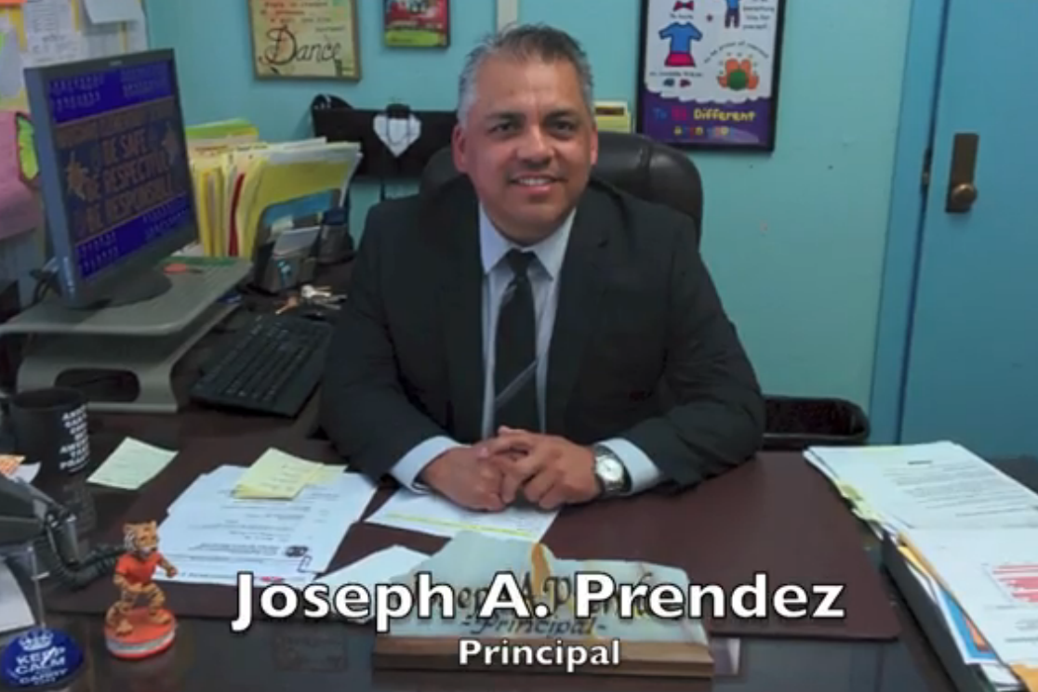
School-Wide Positive Behavior Intervention Support
Administrative Leadership and Support

Slide 3
Behavioral Expectations Defined
We promote positive behaviors on daily basis as we focus on the District school-wide norms:
Be Safe
Be Respectful
Be Responsible
We have made great efforts with our ongoing transformation from a previous year of a divided campus to our current campus where all stakeholders are working together to promote a safe camps and provide college and career readiness for all students.

Slide 4
Behavior Expectations Taught
On the first day of school it was evident that positive behaviors are the expectation for all students and are taught on a daily basis.
We promote positive behavior on daily basis as we focus on the District school wide norms:
Be Safe
Be Respectful
Be Responsible

Slide 5
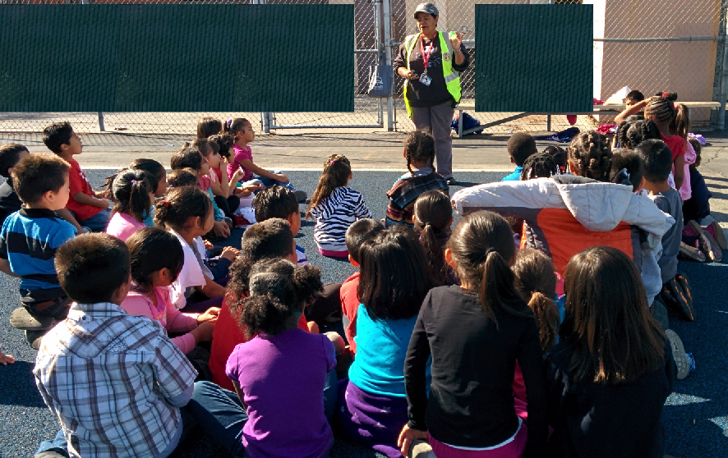

Slide 6

We Follow the Three B's

Slide 7
Students Learn
Responsibility
Leadership Skills
Citizenship

Slide 8
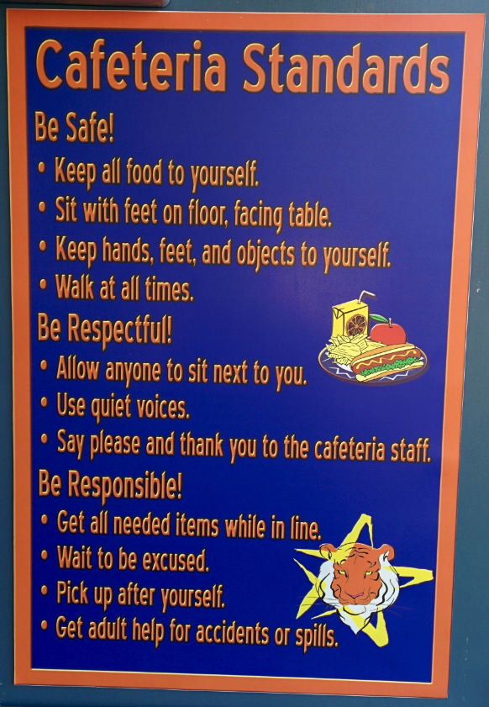

Slide 9
Auditorium Standards
Be Safe!
Keep hands and feet to self.
Sit properly.
Walked to and from your seat.
Be Respectful!
Use Quiet Voices.
Follow the quote “high five “signal.
Show appreciation only by clapping.
Be Responsible!
Be Polite.
Follow adult directions.
Stay in your class.

Slide 10
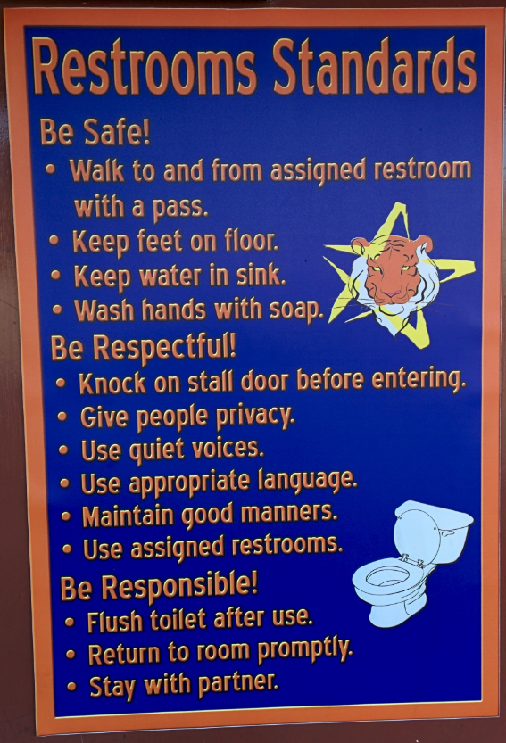

Slide 11
These norms are prevalent throughout the campus with specific emphasis on behavior applications and consequences in each classroom. We have made great efforts with our ongoing transformation from a previous year of a divided campus to our current campus where all stakeholders are working together to promote college and career readiness.

Slide 12
Acknowledge and Reinforce Appropriate Behavior
In addition, our focus on anti-bullying is communicated through our campaign which provides clear alternatives to bullying.

Slide 13
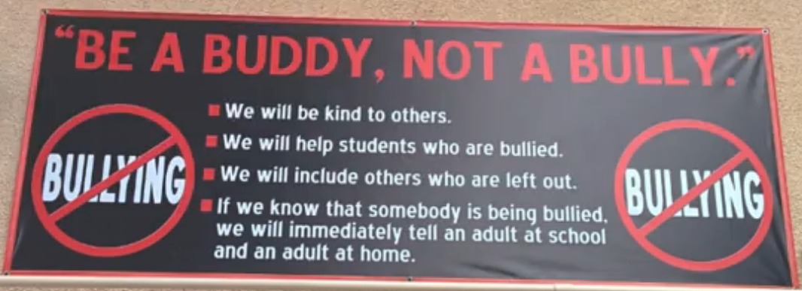

Slide 14
Students Are Aware of School-Wide Expectations

Slide 15


Slide 16
Data Decision Making
Discipline Statistics
Comparison of office Referrals from LY to Current Year
Suspension
Anything he feels comfortable sharing.
Include school contact for more information on presented data.

Slide 17
Family and Community Collaboration
We depend on support from our parents and community partners. We reach out to them by focusing on three important key elements:
Be Relational
Over Communicate
Create an Environment of Inclusion

Slide 18
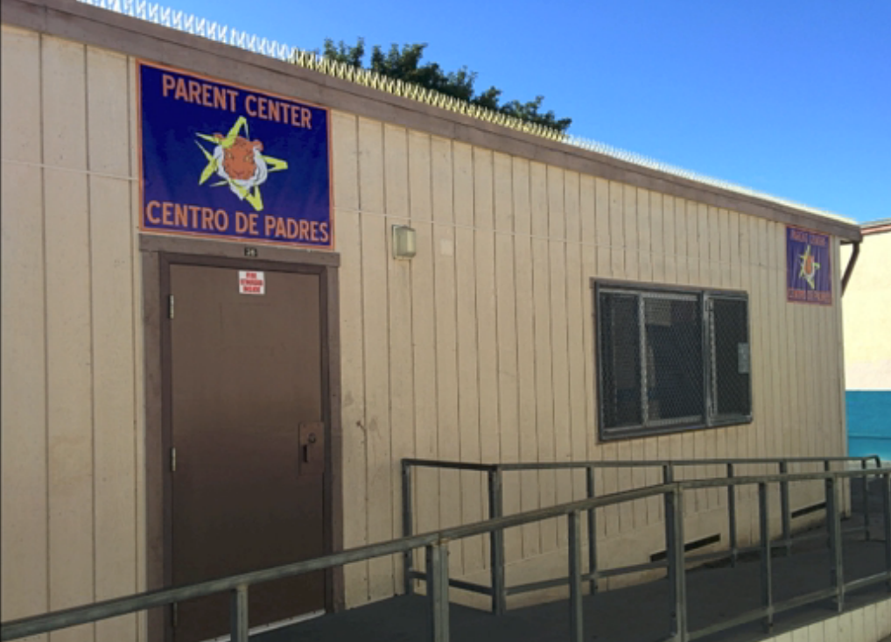

Slide 19
Create an Environment of Inclusion
Volunteer Opportunities
Community Partnerships

Slide 20
Over Communicate!
Communicate with Parents in Their Primary Language
Blackboard Connect Messages
Weekly Parent Update Meetings

Slide 21
Promote Positive
School Culture and Climate
Our Parents are our Partners

Slide 22
We Inspire

Slide 23

“Education is the most powerful weapon which you can use to Change the World.”
-Nelson Mandela
July 18, 1918 – December 5, 2013

Slide 24
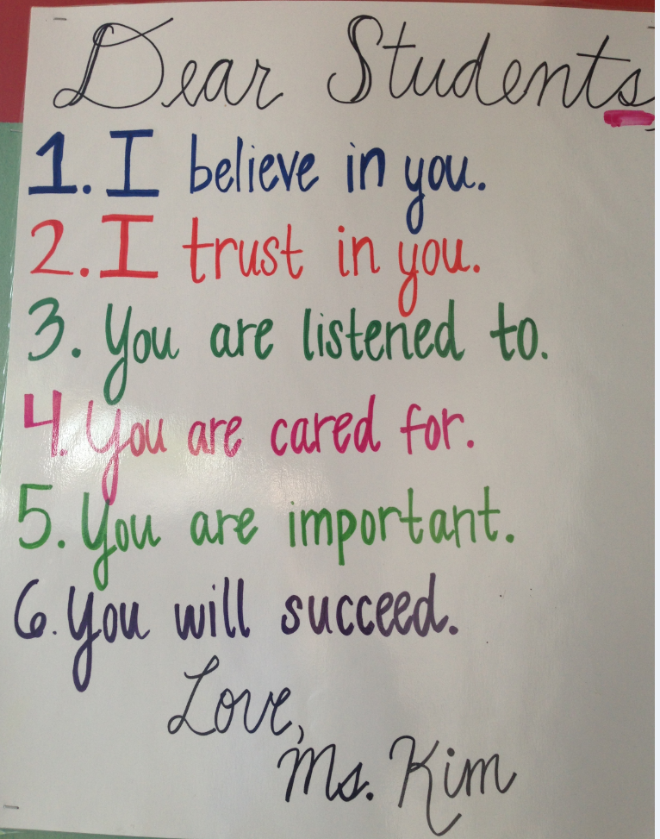

Slide 25
Join us as we celebrate our ongoing transformation…

Slide 26

It's a new day at
Weigand Avenue Elementary

